Slide 1

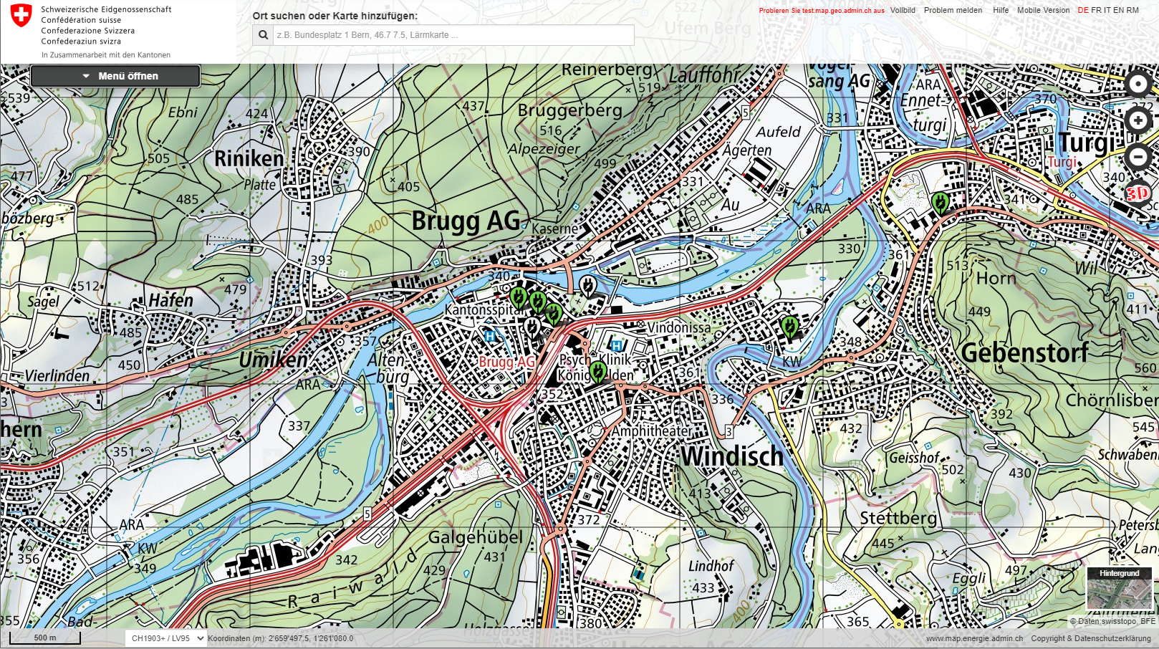
Energy Hackdays Brugg, 28-29.08.2020
Cheapest charging around

Slide 2
CHALLENGE GOAL
Further development of the GIS platform of the Swiss Federal Office of Energy (SFOE): Add price information to the charging stations and find the cheapest option around for electric car drivers.

Slide 3
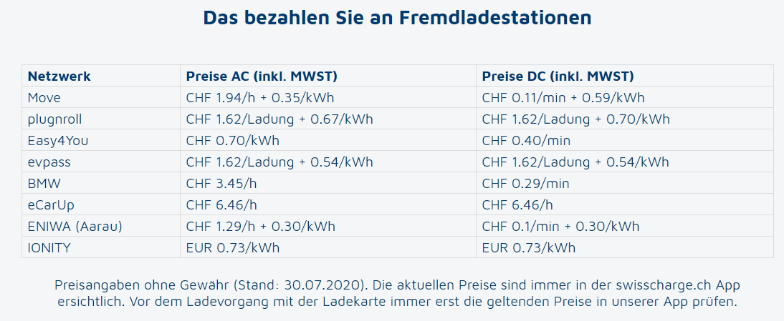
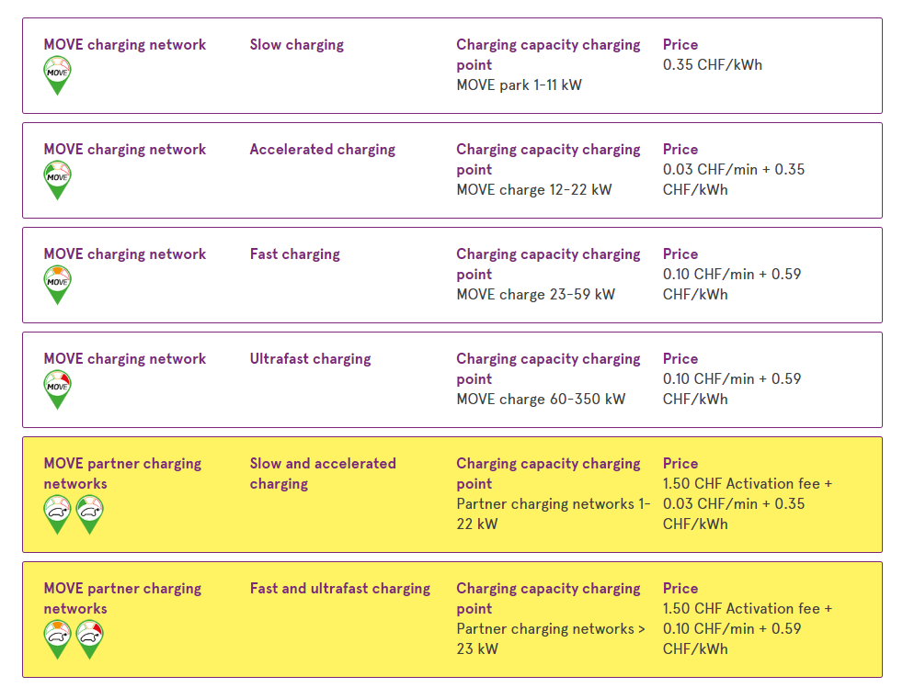
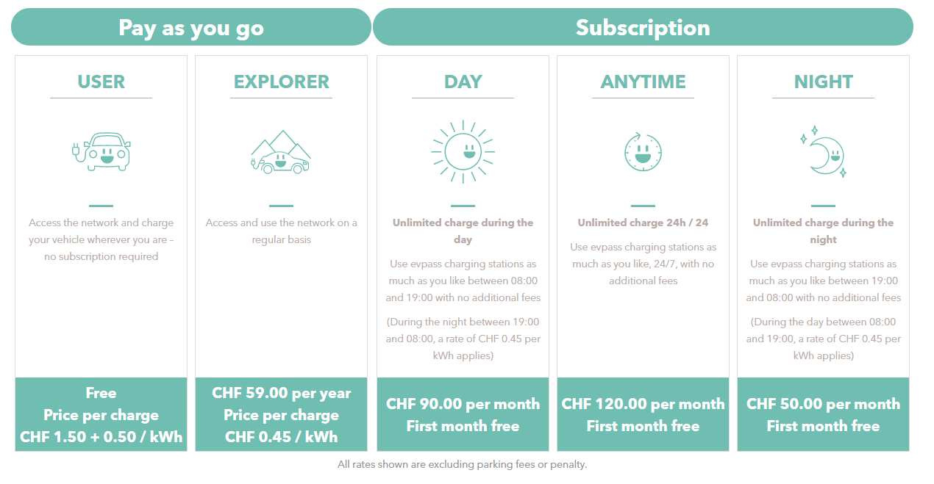
PRICES?
WTF ?
Hidden information, no public API
Roaming vs. own network prices…

Slide 4
IDEA
Database with the tariff plans data
Use the available open data (DIEMO geoJSON, FSDI API) to show the charging stations on a web map and get the plug information
Filter the tariff database to find the valid plans for the selected plug
Present the filtered prices to the user

Slide 5
WHAT WOULD HAVE BEEN NICE TO HAVE?
Openness of the pricing data from all the providers
A uniform standard for price display on the provider side (e.g. in kWh)

